Slide 1
The world’s first global, multi-dimensional, user-driven university* ranking (* includes all higher education institutions) Jordi Curell Director Higher education and international affairs Education and Culture Directorate-General European Commission

Slide 2
U-Multirank: why, what, and how

Slide 3
Higher education in Europe 2020
Why support U-Multirank?
For “Smart, sustainable and inclusive” growth, Europe needs:
(More) well-educated graduates with the right types of knowledge and skills
To draw more effectively on the innovation potential of higher education institutions and their staff
Modernisation agenda in higher education – support member states to:
Increase quality
Increase transparency

Slide 4
History
Proposal 2008 to increase transparency
To make informed choices
But NOT designed to make European universities appear better
A feasibility study concluded in 2011 that a multidimensional ranking was feasible
First ranking 13 May 2014

Slide 5
Higher education needs this
new kind of comparison
The “global system” of higher education is characterised by an
enormous diversity in university profiles and missions
Different groups of stakeholders are interested in different types of performances by universities
But diversity is not yet transparent or understood
Diverse preferences and needs of students, university leaders, academics, business and industry, governments etc.
Notes:
Diverse preferences and needs of students, business and industry, governments, university leaders and academics
etc.

Slide 6
U-Multirank offers a global view
of a large variety of university
profiles
Worldwide
coverage
In 2014, 62% of U-Multirank universities are from Europe, 17% from North America, 14% from Asia and 7% from Africa, Latin America and Oceania
PhD-awarding institutions
+
universities of applied sciences
small
+
large universities
specialised institutions
+
comprehensive universities
old (pre 1870)
+
young institutions
(after 1980)
Latin America in U-Multirank 2014
13 institutions with publicly available data (9 from Brazil),
11 with full data set incl. self-reported data (3 from Brazil)

Slide 7
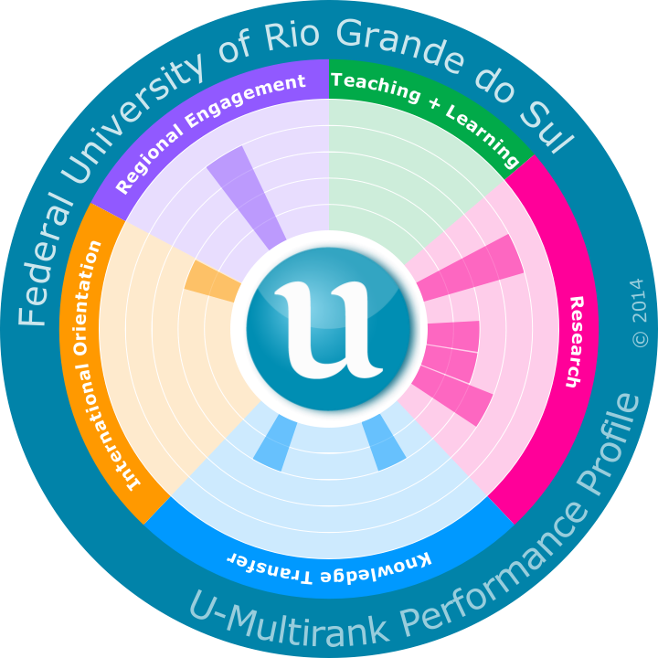
Example profile in U-Multirank

Slide 8
A new instrument to compare
university performance
“University X is the fifth best in the world”
Multi-dimensional ranking: ranks on 30 individual indicators (performance measures) in five dimensions of performance
Teaching and learning | Research
Knowledge transfer | International orientation
Regional engagement

Slide 9
A new instrument to compare
university performance
“Indicator 1 counts for 20%, indicator 2 for 30%, etc., altogether this leads to a score of X”
No composite overall scores, transparency lost if scores are weighted / added
User-driven: user decides on areas of performance to compare (and on the kind of university to be compared) – YOUR WAY!
Notes:
No composite overall scores – transparency lost if scores are weighted/added

Slide 10
A new instrument to compare
university performance
ranking performance of universities as a whole
ranking performance in specific fields or disciplines

Slide 11
U-Multirank 2014 is the most
comprehensive international data
comparison in higher education
850
universities are included with publicly available data
70
countries have universities in U-Multirank
500
of the 879 universities have provided comprehensive data
faculties/departments are included in the four field based rankings (physics, electrical and mechanical engineering, business studies)
1,000
5,000
study programmes within these faculties are included
60,000
students completed the student satisfaction survey
11

Slide 12
Some U-Multirank results

Slide 13
U-Multirank shows a wide
distribution of “A” scores
“A” scores per univ. | % of univs.
0 | 2 %
1 to 5 | 43 %
5 to 10 | 43 %
11 to 15 | 10 %
16 to 21 | 2 %
Very few univs. with no “A” scores
Many univs. have specific strengths
Around 100 univs. have a wide range (>10) of “A” scores
No univ. has “across the board” “A” scores
On individual indicators performance differences between univs. are clearly visible
300 univs. never before seen in global rankings. Of these, 30 have more than 10 “A” scores

Slide 14
Analyses by indicator reveal
information about the state of
higher education
An example
“Interdisciplinary publications” is a new performance measure introduced within U-Multirank
Almost 90% of universities have scores in a fairly narrow band of around 7% to 11% of their total publication output being interdisciplinary
Only 17 universities perform better than this general pattern. None of the top five scorers on this indicator appear in other global rankings
Notes:
Analyses by indicator
“Interdisciplinary publications” is an entirely new bibliometric indicator
Almost 90% of universities score in a narrow band - around 7% to 11% of their total publication output is interdisciplinary
Only 17 universities perform better than this. None of the top five scorers on this indicator appear in other global rankings.

Slide 15
Analyses by indicator reveal
information about the state of
higher education (2)
Spotlight gaps in knowledge: eg
graduate employment – data is often not collected
Student internships
Measurement of learning outcomes
U-Multirank demonstrates for the first time the diversity of university profiles in the international context
300 HEIs never seen before in world rankings now appear, and they perform well
U-Multirank identifies the top performers – but these are different depending on the indicator

Slide 16
U-Multirank 2014 was only
the first step …
2015 registrations are open to end September
More universities will participate in 2015 and beyond
Psychology, computer science and medicine new subject fields in 2015
Music in 2016
to be continued…

